Slide 1
Waves Demos
Open the Mechanical Waves Demo Sheet document!
Type your responses into the document and save it so you have access to it later.

Slide 2

Waves Demo #1

Slide 3
Predict!
Record your prediction on the demo sheet!

Slide 4

Waves Demo #1

Slide 5
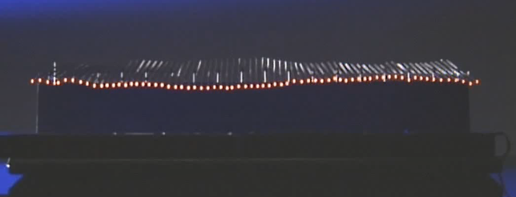
Predict!
There isn’t a pause for this demo. Here’s the setup:

Slide 6

Waves Demo #2

Slide 7
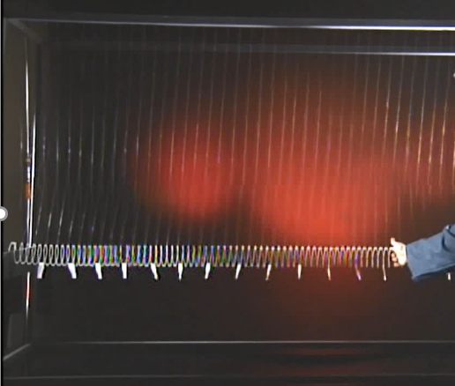
Predict!
There isn’t a pause for this demo. Here’s the setup:

Slide 8

Waves Demo #3

