Slide 1
Metrics and Measurement
“The Basics”

Slide 2
Does Estimation work in Science?

Slide 3
How Tall is $1M?
Given information: Any note of US currency is 0.010922 cm thick
If we stacked 1 million bills on top of each other, how tall would our stack of money be?
109 m (~30 stories!)
That’s the length of a football field and more than half the height of the Space Needle!

Slide 4
Estimation!
How much would $1 million weigh??
Watch video: “How Much Does $1M Weigh?”
He estimated that 1 million dollar bills weighs about 900 kg (~2,000 lbs.)
How close is he? Let’s find out!
So even though estimation is not an “exact science” it is a pretty good tool to use when time is short.

Slide 5
Fermi Problems
Enrico Fermi was famous for rapid estimations that were highly accurate
We’re going to learn how to do these on our own!
  First, some perspective: the scale of the universe
  Next, an example Fermi estimation

Slide 6
Now onto some metrics and measurement!!!

Slide 7
SI - What is it?!
SI = Système Internationale d’Unités
What we know as the “Metric System”
Units are standardized and regulated by two organizations:
  International Bureau of Weights and Measures (in France)
  National institute of Science and Technology (in Maryland)
All measurement tools are calibrated using the standards stored/defined at these locations

Slide 8
Fundamental Units
A quantity that cannot be measured in a simpler form
OR
A quantity that has been selected because of its convenience/practicality
Sometimes also called “base units”

Slide 9
Table 1: SI Fundamental Units and Their Symbols
Quantity | SI Unit | Symbol
Length | Meter | m
Mass | Kilogram | kg
Time | Second | s
Luminous intensity | Candela | cd
Electric current | Ampere | A
Thermodynamic temperature | Kelvin | K
Amount of substance | Mole | mol

Slide 10
Standard Unit Definitions
Meter:
  Definition has been updated several times:
    OLDEST (1790):
      “1/10,000,000 the distance from the north pole to the equator, measured along a line passing through Lyons, France”
    OLD (1875):
      “Distance between two lines engraved on a platinum-iridium bar” in Paris, France
    CURRENT (1984-Present):
      “The distance traveled by light in a vacuum during a time interval of 1/299,792,458 s”
  Length has NOT changed … only updated so definition is more easily repeated in calibration

Slide 11
Standard Unit Definitions
Second:
  OLD (1790):
    “1/86,400 of the mean solar day”
    Updated in 1960 so that ‘mean solar day’ didn’t vary internationally (based on tropical year)
  NOW (1997-present):
    “The duration of 9,192,631,770 periods of the radiation corresponding to the transition between the two hyperfine levels of the ground state of the cesium 133 atom”
    Essentially, the second is based on the vibrations of a cesium-133 atom in an atomic clock ☺

Slide 12
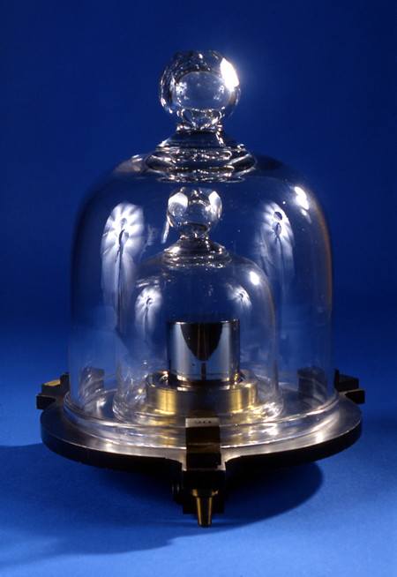
Standard Unit Definitions
Kilogram:
  OLD (1790): mass of exactly one cubic decimeter of water
  CURRENT (1899-present): “the mass of the international prototype of the kilogram” made of platinum-iridium
  FUTURE (2018): Combination of watt balance based on Planck’s constant and physical standard artifact
Photo and Current Definition: NIST Website
2018 New Definition: BIPM Website
Notes:
http://www.nist.gov/pml/si-redef/kg_intro.cfm
http://www.bipm.org/en/bipm/electricity/watt_balance/

Slide 13
Derived Units
Any unit that is formed through the combination of two or more fundamental units
  Examples:
    Area: square meter = m²
    Velocity: meters per second = m/s = m·s⁻¹
    Energy: Joules = J = kg·m²/s² = kg·m²·s⁻²
A conversion of the fundamental unit into one with a different prefix does NOT create a derived unit (i.e. – cm is not a derived unit)

Slide 14
Metric (Exponent) Prefixes
Prefix (symbol) | Conversion Factor | Example
Mega- (M) | 10⁶ | 1 MW = 10⁶ W
kilo- (k) | 10³ | 1 kg = 10³g = 1000 g
centi- (c) | 10⁻² | 1 cm = 10⁻² m = 0.01 m
milli- (m) | 10⁻³ | 1 mL = 10⁻³ L = 0.001 L
micro- (µ) | 10⁻⁶ | 1 µs = 10⁻⁶ s = 0.000001 s

Slide 15
More on Metric Prefixes…
Metric prefixes are used to put numbers into a more usable format….
  For example:
    12000 g is better written as 12 kg
    0.0000065 m is better written as 6.5 μm
For ALL of your measurements and calculated answers, make sure that you are using the most logical unit for that measurement!

Slide 16
A desk was measured to be 62.52 cm tall. How many millimeters tall is this desk?
6252 mm
625.2 mm
6.252 mm
0.6252 mm
Notes:
[B. 625.2 mm]

Slide 17
The world's largest strawberry was measured to be 231 g. How many kilograms is this?
2.31 kg
23.1 kg
.0231 kg
.231 kg
Notes:
[D. 0.231 kg]

Slide 18
Which of the following is NOT a fundamental unit?
meter
gram
candela
second
Notes:
[B. gram]

Slide 19
What is the approximate mass of a 2 L bottle of pop?
0.5 kg
2 kg
5 kg
10 kg
Notes:
~ 1 g / mL so 2L = [B. 2kg]

Slide 20
Scientific Notation
Scientific Notation helps us put really big numbers or really small numbers into an easier format to read.
  For example:
    The average distance from the Earth to the Moon is about 239,000 miles.
    In scientific notation, this is written as 2.39x10⁵ mi
General Rule of Thumb:
  Count how many times you need to move the decimal place so there’s only one digit out in front
    To the left is a + exponent and to the right is a - exponent

Slide 21
Convert to Scientific Notation
The distance between the Earth and Sun is 93,000,000 miles.
The distance between the Sun and the nearest star is roughly 23,000,000,000,000 miles.
The mass of the Moon is about 74,000,000,000,000,000,000,000 kilograms.
Notes:
2.3 E 13

Slide 22
Convert to Scientific Notation
The distance between the Earth and Sun is 93,000,000 miles.
9.3 x 10⁷ mi
Notes:
9.3 E 7

Slide 23
Convert to Scientific Notation
The distance between the Sun and the nearest star is roughly 23,000,000,000,000 miles.
2.3 x 10¹³ mi
Notes:
2.3 E 13

Slide 24
Convert to Scientific Notation
The mass of the Moon is about 74,000,000,000,000,000,000,000 kilograms.
7.4 x 10²² kg
Notes:
7.4 E 22

Slide 25
Factor-Label Method for Conversions
When converting from one unit to another (i.e. kg → g, or feet → meters), we use conversion factors
Conversion factors tell us the equivalent magnitude in the new unit
  For example:
    1 in. = 2.54 cm
    1 lb = 454 g
    1 kg = 2.2 lb
    1 mi = 1609 m

Slide 26
Factor-Label Method for Conversions
When converting, we make fractions (ratios) out of the conversion factors so that the original unit divides out (cancels out) and the new unit remains:
  Example:
    2.75 pounds is equal to how many kilograms?

Slide 27
Factor-Label Practice
The Space Needle is 605.0 ft tall (base to top of the antenna). How many meters is this? (show ALL conversions in one long line:
ft → in → cm → m
605.0 ft | 12 in | 2.54 cm | 1 m | = 184.4 m
 | 1 ft | 1 in | 100 cm
Notes:
605 ft (*12) -> 7260 in (*2.54) -> 18,440.4 cm ( / 100) ->[ANSWER: 184.4 m]

Slide 28
Factor-Label Practice
Michael Phelps holds the Olympic Record for the 200m butterfly from his race at the Beijing Olympics with a time of 1:52:03. His average speed was 1.8 m/s. How fast was he swimming in miles per hour?
1.8 m | 1 mi | 60 s | 60 min | = 4.0 mph
s | 1609 m | 1 min | 1 hr
Notes:
21 mi = 1609 m
[2m/1s] [1 mi/1609m] [3600s/1hr] = [ANSWER: 4.5 mph]

Slide 29
A cheetah can run at speeds up to 70.0 miles per hour. How fast is this in meters per second?
1877 m/s
2.6 m/s
157 m/s
31.3 m/s
70.0 mi | 1609 m | 1 hr | = 31.3 m/s
hr | 1 mi | 3600 s
Notes:
[70 mi/1 hr] [1609 m/1 mi] [1 hr/3600 s] = [ANSWER: 32.3 m/s]

Slide 30
Putting It Into Perspective!
Watch Powers of Ten (1977)
  https://www.youtube.com/watch?v=0fKBhvDjuy0

